Slide 1

Application of a nonparametric regression model on a dataset
MOUPARNA MUKHERJEE
Enrollment No.:A8979219002
Date: 18/08/2020

Slide 2

The project was completed under the guidance of
Dr. Partha Sarathi Mukherjee Indian Statistical Institute, Kolkata
Interdisciplinary Statistical Research Unit Indian Statistical Institute
203 B.T. Road
Kolkata 700108, India
Summer 2020

Slide 3
INTRODUCTION
In many real life data, the assumptions behind linear regression do not hold.
Therefore, it is necessary analyze those data with other techniques.
One such approach is nonparametric regression.
Nadaraya-Watson kernel regression is one of the oldest nonparametric regression methods.
I first give a brief description of this method and then will analyze one dataset.

Slide 4
REVIEW STUDY
I have learned Nadaraya - Watson Kernel regression from various sources .
Source are given in the references .

Slide 5
OBJECTIVE:-
Our objective is to estimate the regression function non-parametrically.

Slide 6
DATA AND METHODOLOGY:-
Model:-
So , our model is :-
y_{i} = g(x_{i} ) + e_{i}
Where , x_{i} ’s are fixed ; e_{i} ’s are random ; g is a unknown continuous
function.
Assumptions:-
E(ei) = 0 .
ei may or may not be normally distributed .
g may or may not be linear .
Method :-
For estimation of parameters non-parametrically there are various procedures .
But , here we are using “Nadaraya-Watson Kernel Regression” Method.
By this method we can estimate ‘g(x)’ for any x in the data-range.

Slide 7
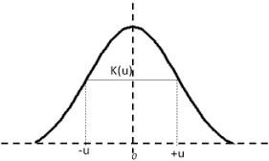
KERNEL FUNCTION :-
Properties:-
This function is symmetrical .
So, mathematically we can expressed it as :- K (+u) = K (-u) .
Symmetrical graph:-
The area under the curve must be equal to one.
So, mathematically we can expressed it as :-
+∞
k (u) du = 1
−∞
We can choose kernel function as non -negative. So, mathematically we can expressed it as :-
K(u) ≥ 0 , − ∞ ⟨ u ⟨ + ∞ .

Slide 8
KERNEL FUNCTION ESTIMATE
Our Gaussian Kernel function is :-
Where,
h= bandwidth x= value
xi= observed values
Now, we define weights :-
w₁ , w₂ ,...... , w_{n} .
So,

Slide 9
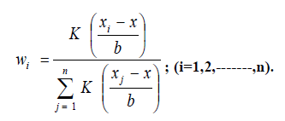
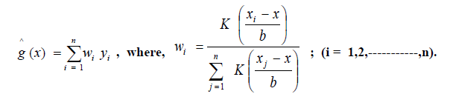
where, ‘b’ is a positive number and b is also called bandwidth.
Bandwidth ‘b’ is also said to be ‘Tunning Parameter’ .
So ,‘b’ control slowly/ rapidly the weights which decreases as moves away from x.
Therefore, “Nadaraya-Watson Kernel Regression” estimate g(xi
So, once we choose Kernel function and a value for ‘b’ we can easily estimate gˆ .

Slide 10
BANDWIDTH SELECTION
Now, we want to select a “reasonable” value for the bandwidth parameter ‘b’. One such approach is :- Cross - Validation ( C.V ) .
CONCEPT:-
First fix any value of ‘b’. Suppose, we delete the i^{th} observation
( xi , yi) keeping the rest. Using the rest of the data , fit ‘Nadaraya –
Watson Kernel’ regression and predict the response (y) . When x= xi , that is, the predictor value of the deleted observation.
CALCULATION:-
)² , where , = ĝ(-i) (xi)
C.V = (yi –

Slide 11
i.e, the predicted value of y , when x=xi after deleting the i^{th}observation.
METHOD:-
Then, one-by-one repeat the process, ∀(i=1,2,......,n).
When i=1, use (x2,y2),........., (xn,yn),
When i=2, use (x1,y1),........., (xn,yn), etc. Now, calculate:- CV-Score=∑(yi – )² .
Try another value of b which gives smallest CV-Score. Note, small CV-Score means better fit for that value of b.

Slide 12
RESULT AND DISCUSSION
Data set in R : faithful [2].
Desciption of the data : Waiting time between eruptions and duration of the eruption for the old faithful geyser (hot spring) in Yellowstone National Park , Wyoming , USA.
This is a data frame with 272 observations on 2 variables [,1]
eruptions numeric Eruption time in minutes [,2] Waiting numeric Waiting time to next eruption ( in minutes).

Slide 13
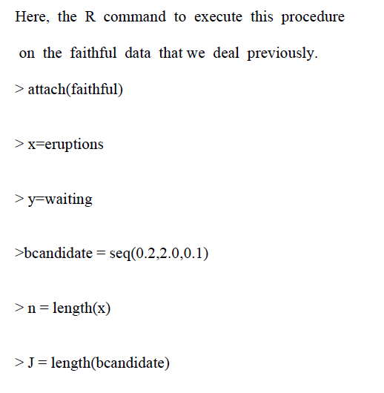
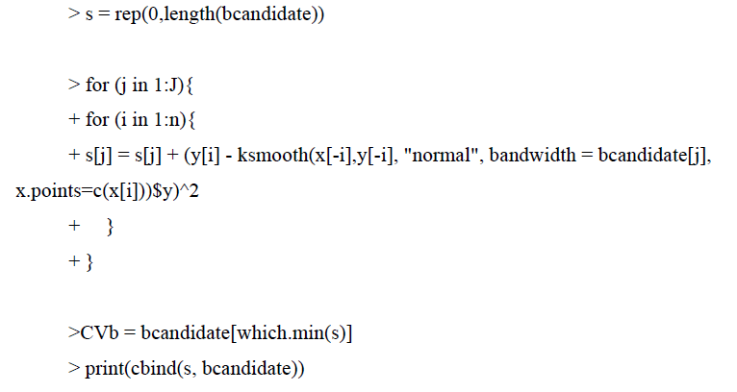
R-Codes for cross-validation:

Slide 14
TABLE: CV-scores for faithful Data:-
CV_Score b-candidate
[1,] 9425.902 | 0.2
[2,] 9058.730 | 0.3
[3,] 8895.443 | 0.4
[4,] 8822.309 | 0.5
[5,] 8792.207 | 0.6
[6,] 8784.602 | 0.7
[7,] 8788.211 | 0.8
[8,] 8796.496 | 0.9
[9,] 8805.301 | 1.0
[10,] 8811.706 | 1.1
[11,] 8814.650 | 1.2
[12,] 8813.856 1.3
[13,] 8810.137 1.4
[14,] 8805.815 1.5
[15,] 8804.312 1.6
[16,] 8810.335 1.7
[17,] 8829.672 1.8
[18,] 8868.770 1.9
[19,] 8935.162 2.0
Therefore , we get the estimate of b as b = 0.7.

Slide 15
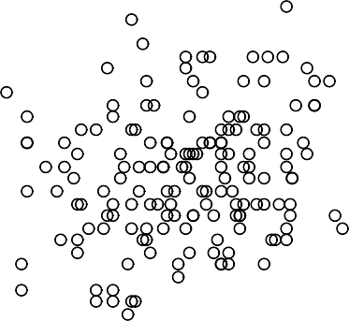
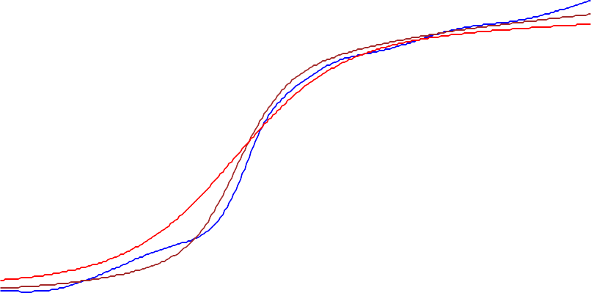
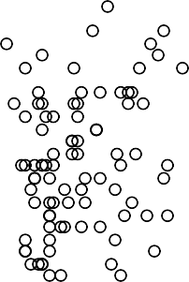
RESULT WITH OUTPUT AND GRAPH
Waiting Time to Next Eruption(min)
90
80
70
60
50
1.5
2.0
2.5
3.0 3.5 4.0
Eruption Time(min)
4.5
5.0
Figure 1: Fitted function for various bandwidth values

Slide 16
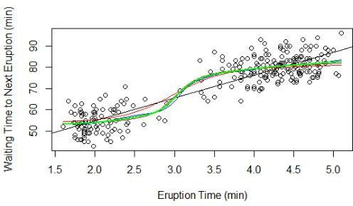
Figure 2: Fitted functions for various bandwidths and the fitted simple linear regression

Slide 17
REFERENCE AND CONCLUSION
CONCLUSION
We can clearly see that :--
Nadaraya-Watson kernel regression is more appropriate tool .
To analyze certain data compared to usual linear regression.

Slide 18
References:-
[1]: https://towardsdatascience.com/kernel-regression-made-easy
to-understand-86caf2d2b844
[2]: https://www.r-project.org/

Slide 19
THANK YOU

